Slide 1


CALL ATTENTION TO RUMORS DEEP ATTENTION BASED RECURRENT NEURAL NETWORKS FOR EARLY
RUMOR DETECTION
STUDENTS
SHAY AXELROD 312592199
YANA MAMEDOV 316882646
SUPERVISOR
ZEEV VOLKOVICH
CAPSTONE PROJECT
B-21-1-b-45
DATE
JANUARY 19, 2020

Slide 2
BRIEF DESCRIPTION
The project is intended to detect rumors at early stages before spreading
Based on a state-of-the-art technology featuring recurrent neural network (RNN) and is enhanced with soft attention mechanism
Designed to be trained on large datasets
Designed to work on a text documented input

Slide 3
MOTIVATION – WHY BOTHER DETECTING RUMORS?
Online rumors are being spread by many on a daily basis
Side effects caused by rumors include:
Impulsive actions – Selling/Buying stock shares without too much thinking
Health concerns – Affected victims may change their diets or even harm themselves
National/Global scare – People may be frightened on a large scale

Slide 4
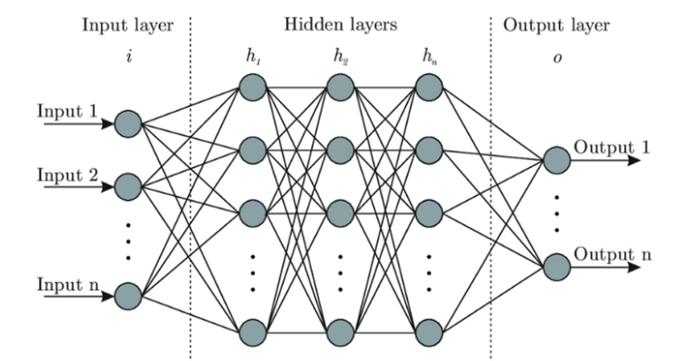
INTRODUCTION
An authentic solution involves operating with RNNs and attention mechanisms aiming to automatically learn certain text representations useful for rumors identifying
RNN is a class of artificial neural networks, where connection between nodes form a directed graph along temporal sequences

Slide 5
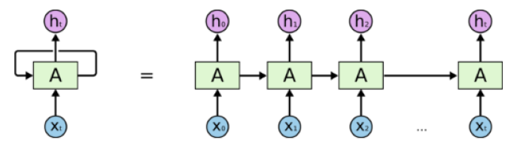
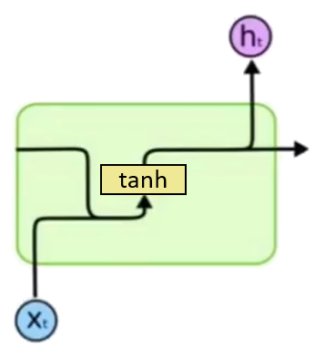
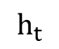
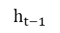
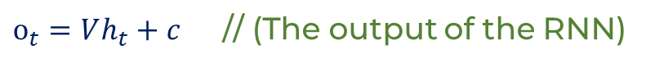
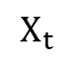
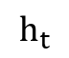
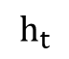
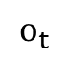
INTRODUCTION – RECURRENT NEURAL NETWORK (RNN)
RNNs are feed-forward neural networks that are used for processing sequential data.
The output of the RNN goes back as being the input of the RNN for the next time step
Most Basic RNNs use the tanh activation to regulate values in the network
Those RNNs suffer from “the vanishing gradient problem” (solved with LSTM)
$$h_{t}=\tanh\left(Ux_{t}+Wh_{t−1}+b\right)$$
$$h_{t}$$
$$o_{t}$$
$o_{t}=Vh_{t}+c$ // (The output of the RNN)
$$h_{t}$$
$$h_{t−1}$$
$$h_{t}$$
tanh
$$X_{t}$$
An unrolled recurrent neural network
RNN

Slide 6
MAIN CHALLENGES
RNNs suffer from the vanishing gradient problem, thus long sequential data is a bit tricky to handle
The system adopts new features automatically
Many duplications of posts with different contextual variations are taken care of

Slide 7
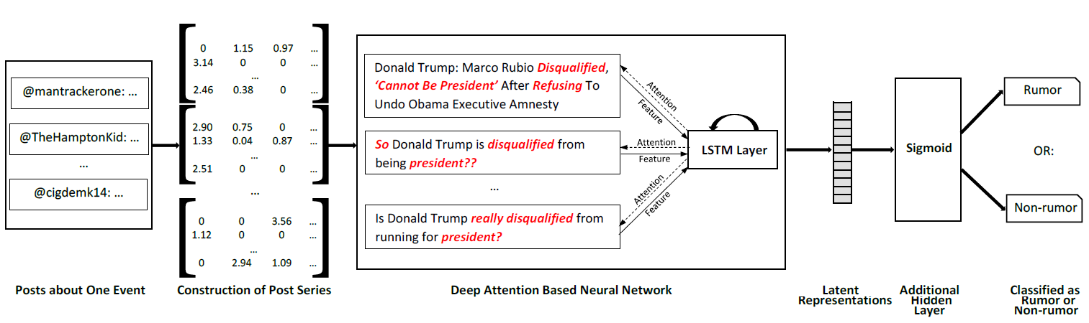
THE ALGORITHM – FLOW CHART
I
II
III
IV
Additional Hidden Layer
Classified as Rumor or Non-rumor
Latent Representations
Different Posts
Construction of Post Series
Deep Attention Based Neural Network

Slide 8
THE ALGORITHM – DIFFERENT POSTS
I
II
III
IV
Additional Hidden Layer
Classified as Rumor or Non-rumor
Latent Representations
Different Posts
Construction of Post Series
Deep Attention Based Neural Network

Slide 9
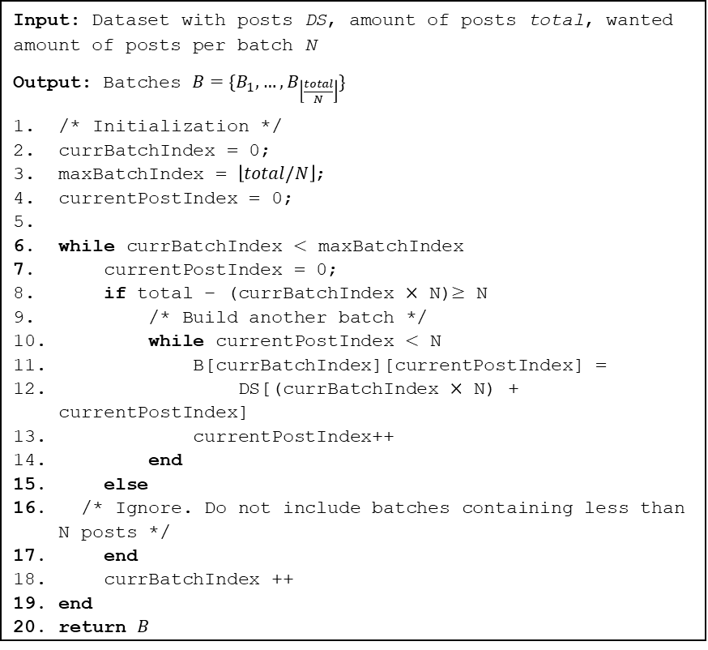
THE ALGORITHM – DIFFERENT POSTS
Input: Dataset with posts DS, amount of posts total, wanted amount of posts per batch N
Output: Batches $B=\{B_{1}, …, B_{\left\lfloor \frac{total}{N}\right\rfloor }\}$
/* Initialization */
currBatchIndex = 0;
maxBatchIndex = $\left\lfloor total/N\right\rfloor$;
currentPostIndex = 0;
while currBatchIndex $<$ maxBatchIndex
currentPostIndex = 0;
if total – (currBatchIndex $×$ N)$≥$ N
/* Build another batch */
while currentPostIndex $<$ N
B[currBatchIndex][currentPostIndex] =
DS[(currBatchIndex $×$ N) + currentPostIndex]
currentPostIndex++
end
else
/* Ignore. Do not include batches containing less than N posts */
end
currBatchIndex ++
end
return $B$
The model gets a large sequence of posts and groups them together to form a batches. This process is done using algorithm 1.
@Drake11: Bibi’s first born is adopted
@Martha: Israel’s prim minister adopted a child!
Drake11 bibis first born is adopted martha Israels prim minister adopted a child Samantha who is <url>
@Samantha: Who is https://facebook.com/argentina?
Example: Posts from random people are batched together
Algorithm 1: Constructing Variable-Length Post Series

Slide 10
THE ALGORITHM – CONSTRUCTION OF POST SERIES
I
II
III
IV
Additional Hidden Layer
Classified as Rumor or Non-rumor
Latent Representations
Different Posts
Construction of Post Series
Deep Attention Based Neural Network

Slide 11
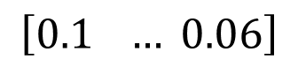
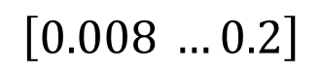
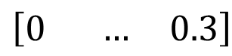
THE ALGORITHM – CONSTRUCTION OF POST SERIES
In this stage the model calculates the tf-idf reflecting how important words are in their batch.
Drake11 bibis first born is adopted martha Israels prim minister adopted a child Samantha who is <url>
Drake11 bibis first born is adopted martha Israels prim minister adopted a child Samantha who is <url>
tf
$$\left[0.1 … 0.06\right]$$
Number of batches
$$\left[0 … 0.3\right]$$
tf-idf
$$\left[0.008 …0.2\right]$$

Slide 12
THE ALGORITHM – CONSTRUCTION OF POST SERIES
Then a vector for each batch in the size of K is built, where K represents the amount of words in that batch’s dictionary. These vectors are then fed into the RNN.
Drake11 bibis first born is adopted martha Israels prim minister adopted a child Samantha who is <url>
Drake11 bibis first born is adopted martha Israels prim minister adopted a child Samantha who is <url>
$$\left[0.1 … 0.06\right]$$
Number of batches
$$\left[0 … 0.3\right]$$
tf-idf
$$\left[0.008 …0.2\right]$$

Slide 13
THE ALGORITHM – DEEP ATTENTION BASED RNN
I
II
III
IV
Additional Hidden Layer
Classified as Rumor or Non-rumor
Latent Representations
Different Posts
Construction of Post Series
Deep Attention Based Neural Network

Slide 14
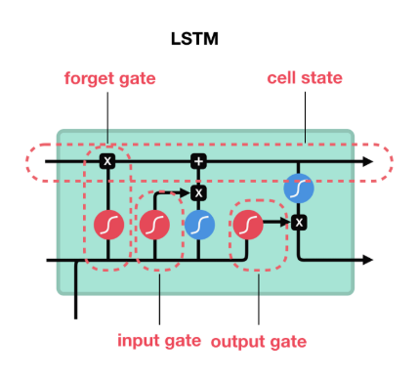
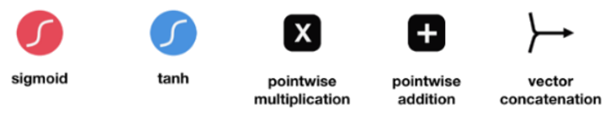
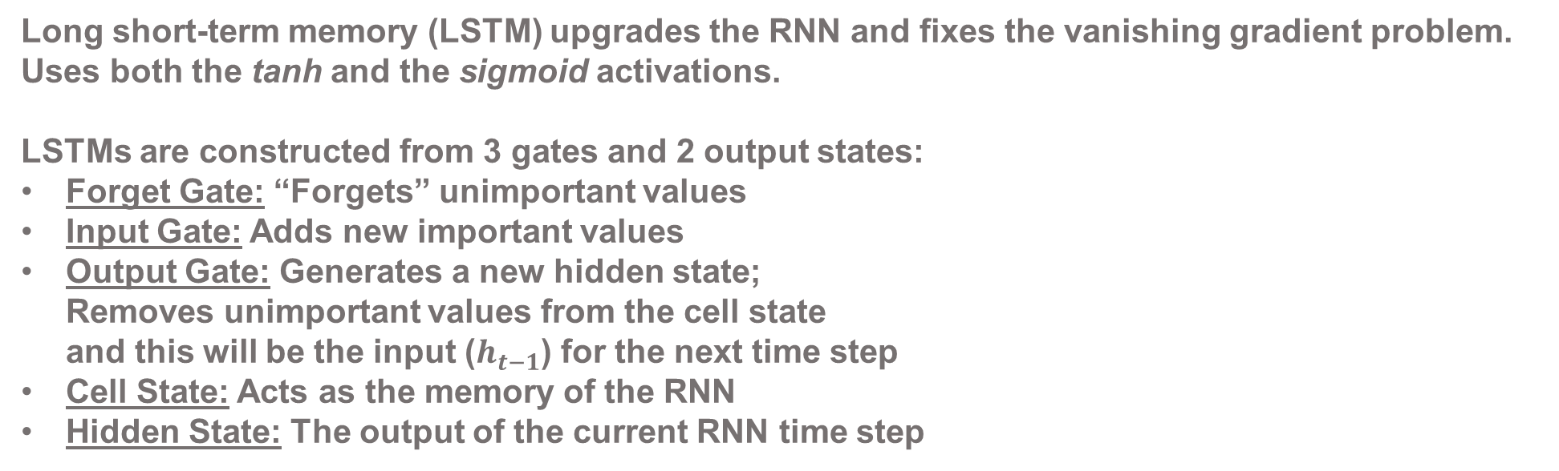
TOOLS – LSTM
Long short-term memory (LSTM) upgrades the RNN and fixes the vanishing gradient problem. Uses both the tanh and the sigmoid activations.
LSTMs are constructed from 3 gates and 2 output states:
Forget Gate: “Forgets” unimportant values
Input Gate: Adds new important values
Output Gate: Generates a new hidden state; Removes unimportant values from the cell state and this will be the input ($h_{t−1}$) for the next time step
Cell State: Acts as the memory of the RNN
Hidden State: The output of the current RNN time step
$$f_{t}=σ(U_{f}h_{t−1}+W_{f}x_{t}+V_{f}c_{t−1}+b_{f})$$
$$i_{t}=σ(U_{i}h_{t−1}+W_{i}x_{t}+V_{i}c_{t−1}+b_{i})$$
$$o_{t}=σ(U_{o}h_{t−1}+W_{o}x_{t}+V_{o}c_{t}+b_{o})$$
$$c_{t}=f_{t}c_{t−1}+i_{t}tanh⁡(U_{c}h_{t−1}+W_{c}x_{t}+b_{c})$$
Visual example of an SLTM with all its gates
$$h_{t}=o_{t}tanh⁡(c_{t})$$

Slide 15
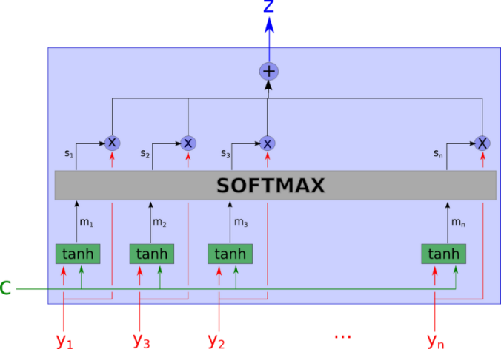
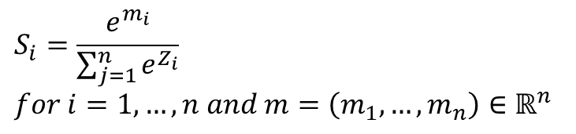
TOOLS – ATTENTION MECHANISM
Attention has a large impact on neural computation as it selects the most relevant information for the RNN rather than using all the available information.
The attention mechanism focuses the RNN’s input on specific words.
Attention mechanisms use the SOFTMAX function to calculate probability distributions
Our model uses soft-attention, a deterministic mechanism
Softmax function:
$$S_{i}=\frac{e^{m_{i}}}{\sum_{j=1}^{n}{e^{Z_{i}}}} \\ for i=1, …, n and m=\left(m_{1},…,m_{n}\right)∈ℝ^{n}$$
A visual explanation to how a soft attention mechanism works. The input is entered from the bottom, undergoes some mathematical manipulations and outputs from the top

Slide 16
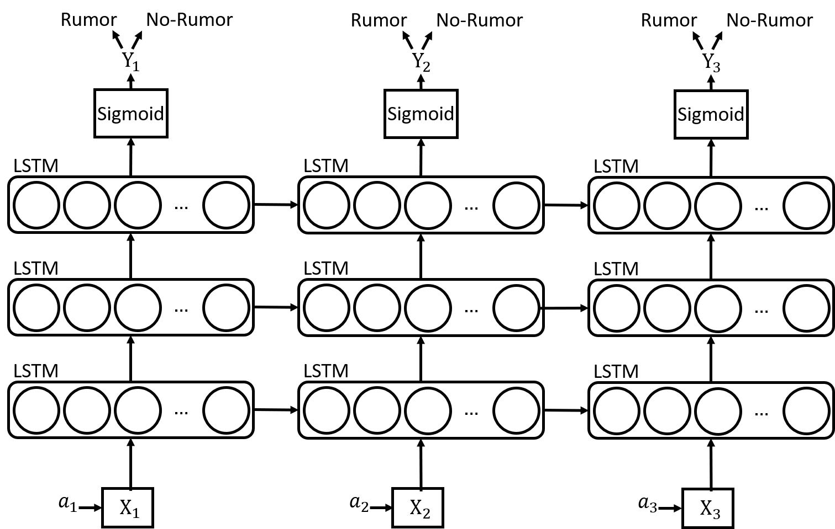
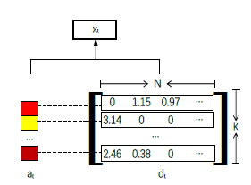
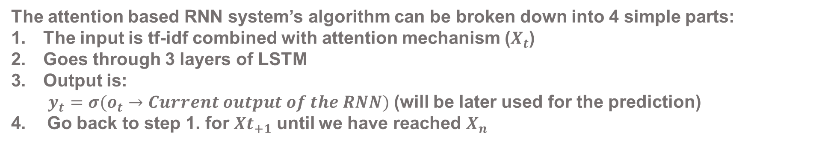
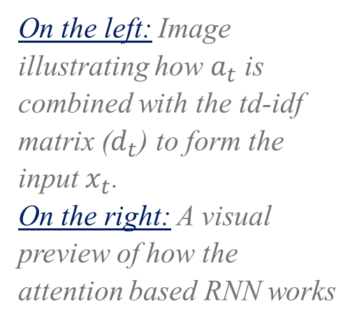
THE ALGORITHM – DEEP ATTENTION BASED RNN
The attention based RNN system’s algorithm can be broken down into 4 simple parts:
The input is tf-idf combined with attention mechanism ($X_{t}$)
Goes through 3 layers of LSTM
Output is:
$y_{t}=σ(o_{t}→Current output of the RNN)$ (will be later used for the prediction)
Go back to step 1. for ${Xt}_{+1}$ until we have reached $X_{n}$
On the left: Image illustrating how $a_{t}$ is combined with the td-idf matrix ($d_{t}$) to form the input $x_{t}$. On the right: A visual preview of how the attention based RNN works
left
right

Slide 17
THE ALGORITHM – CLASSIFICATION
I
II
III
IV
Additional Hidden Layer
Classified as Rumor or Non-rumor
Latent Representations
Different Posts
Construction of Post Series
Deep Attention Based Neural Network

Slide 18


THE ALGORITHM – CLASSIFICATION
In this final stage, the algorithm does a sigmoid activation on the y vector and predicts if it is a rumor or not.
Rumor
OR
Not A Rumor

Slide 19
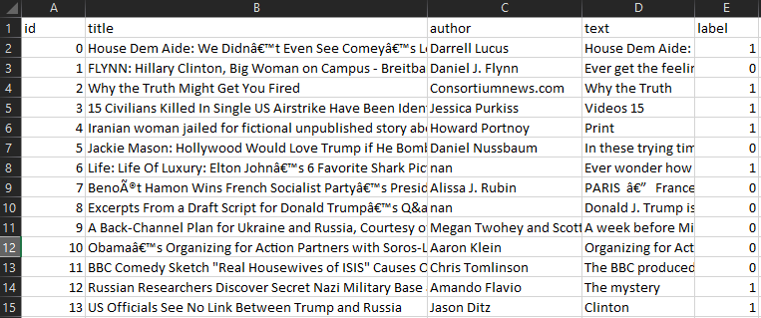
TRAINING – PRACTICE MAKES PERFECT
The system must be trained before it can make accurate predictions
Our model is trained using a datasets from Kaggle consisting of ~18,000 labeled posts
The best performance the model got is 89% accuracy, and 28% loss.

Slide 20
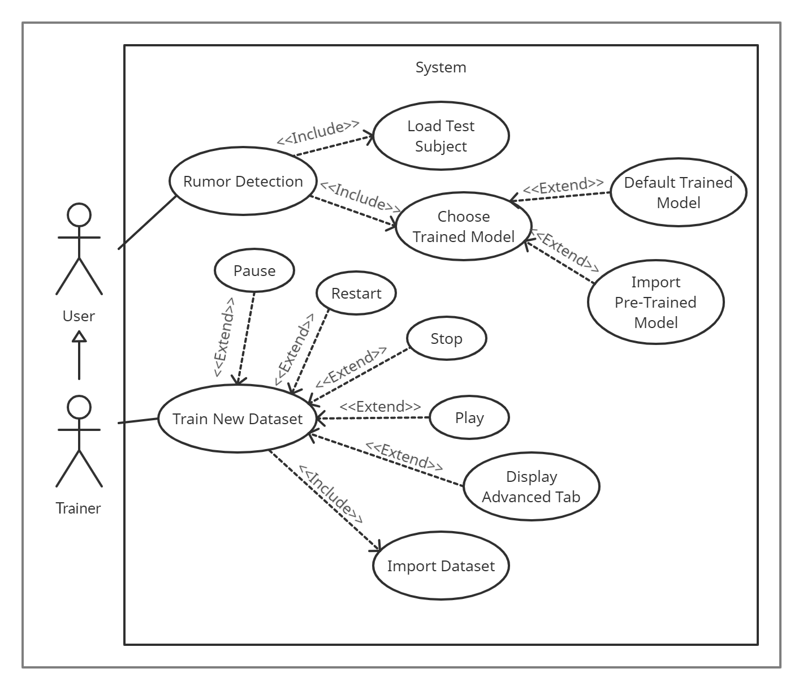
USE CASE DIAGRAM

Slide 21
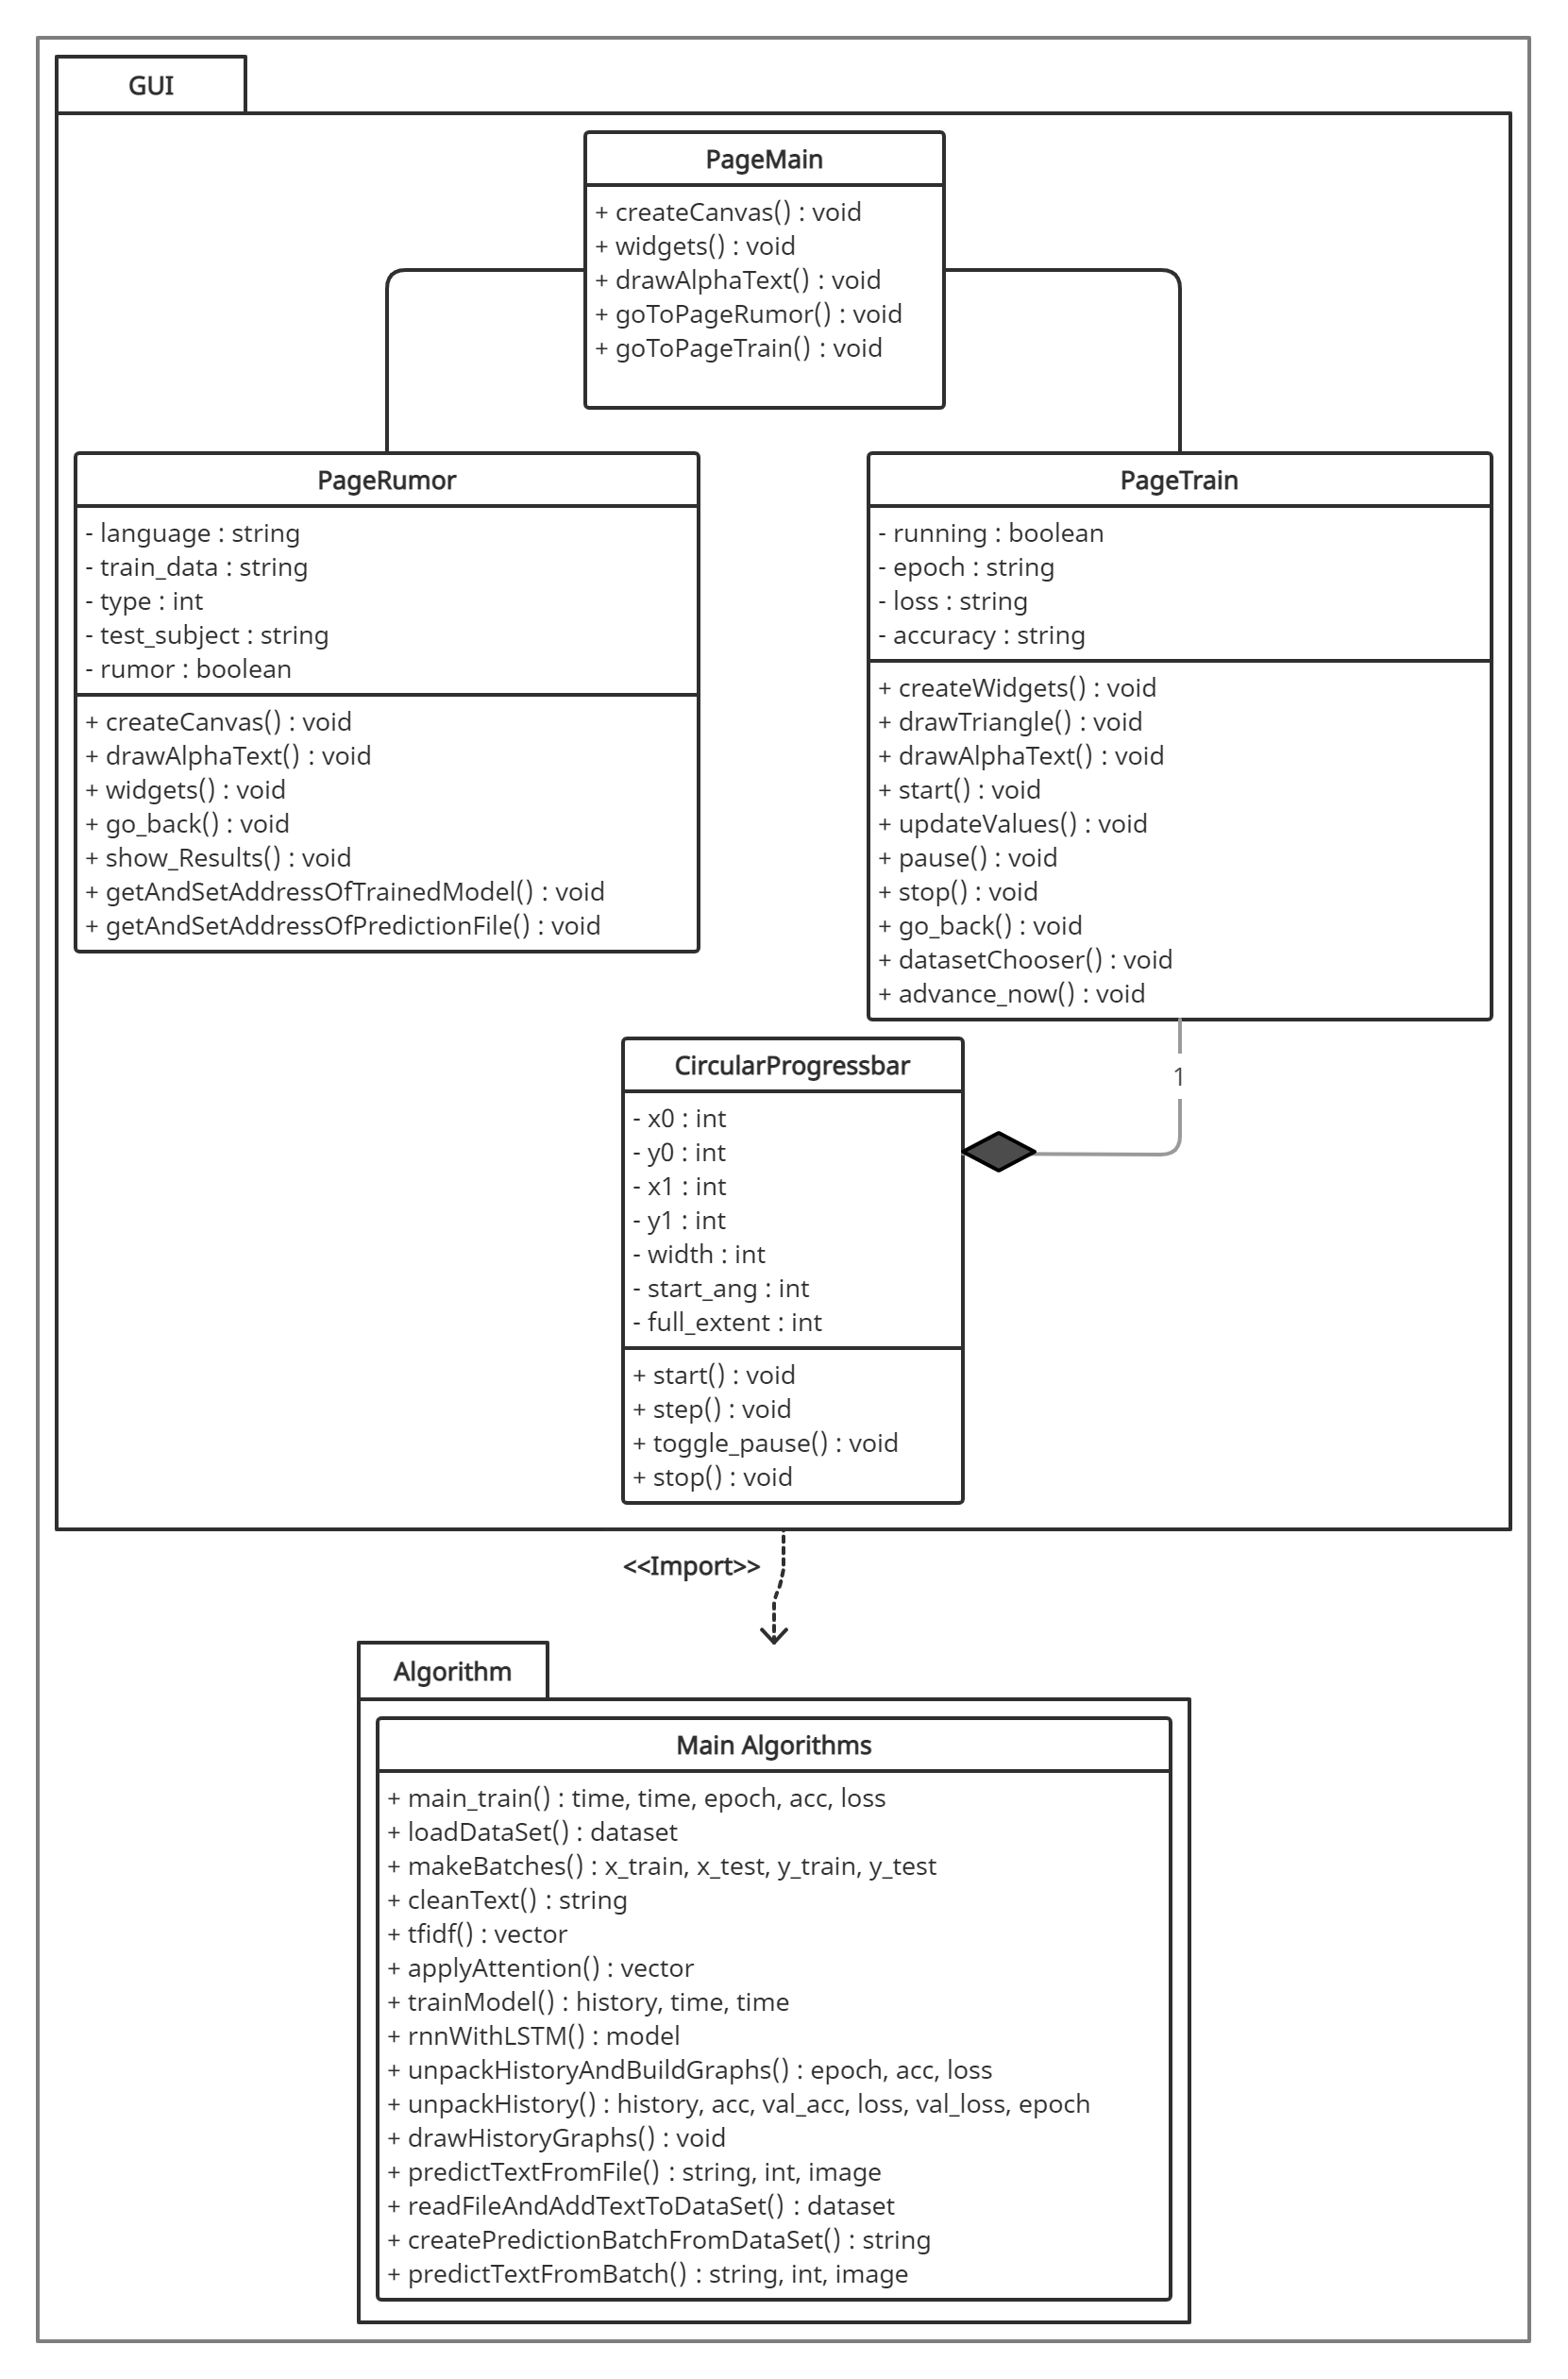
CLASS DIAGRAM
<<Import>>
21

Slide 22
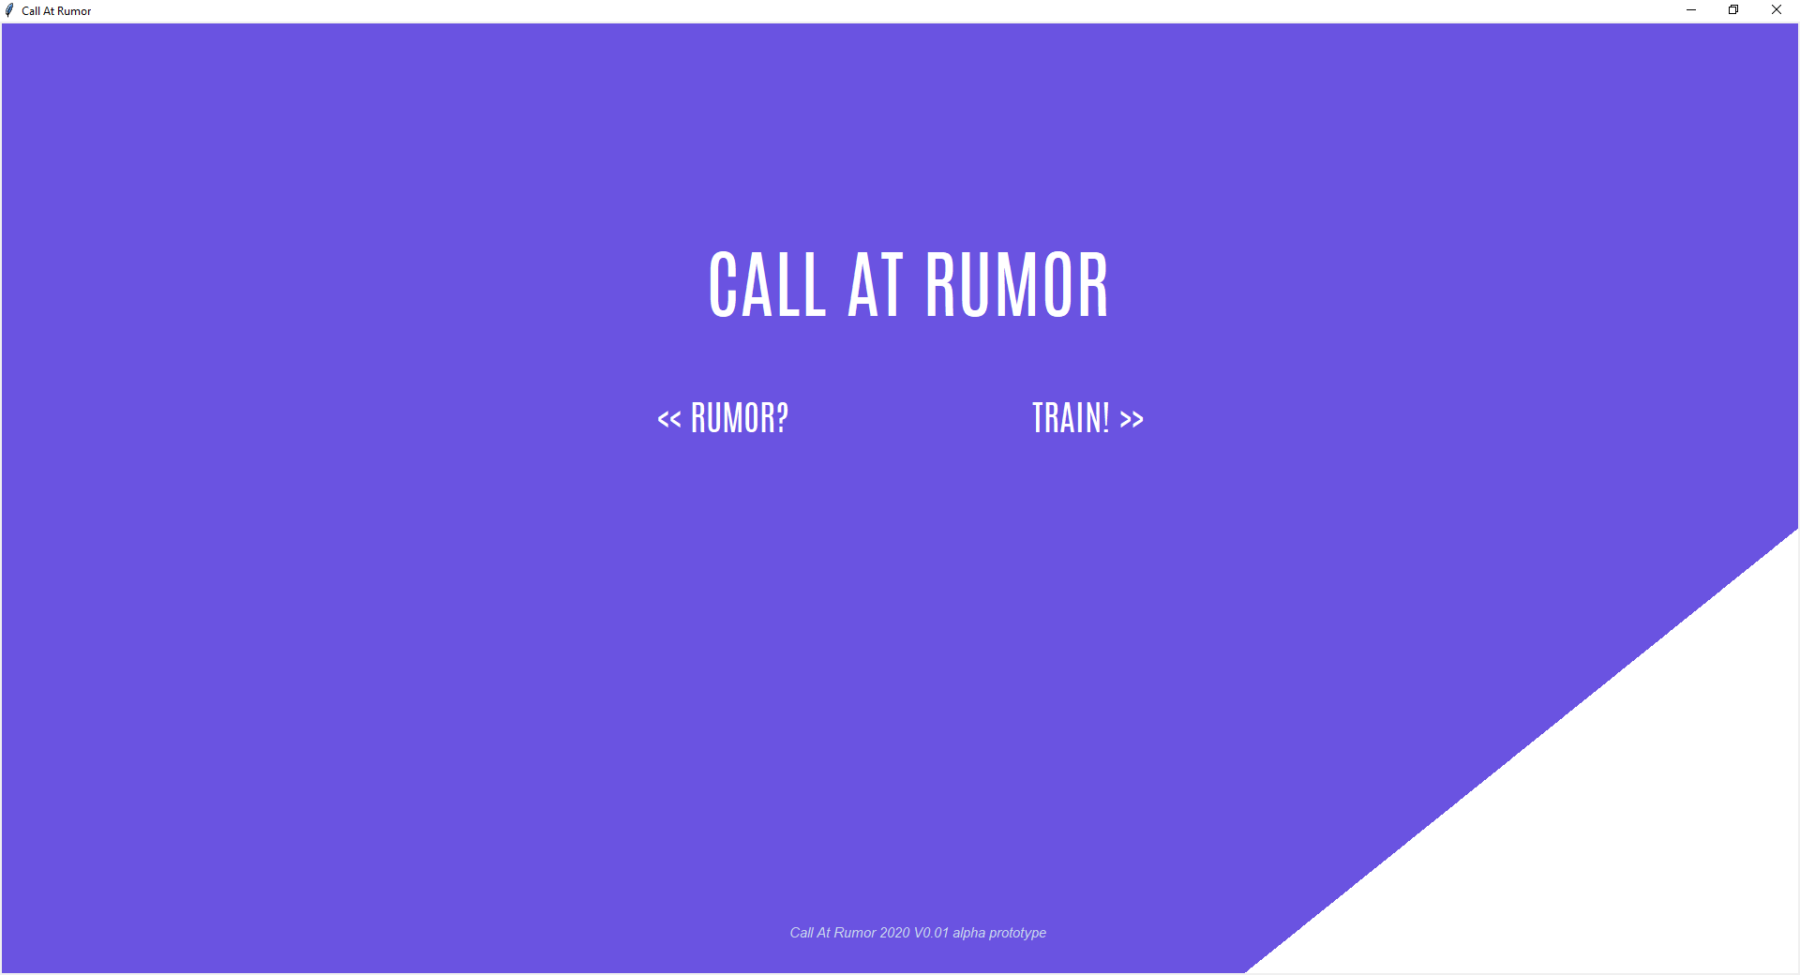
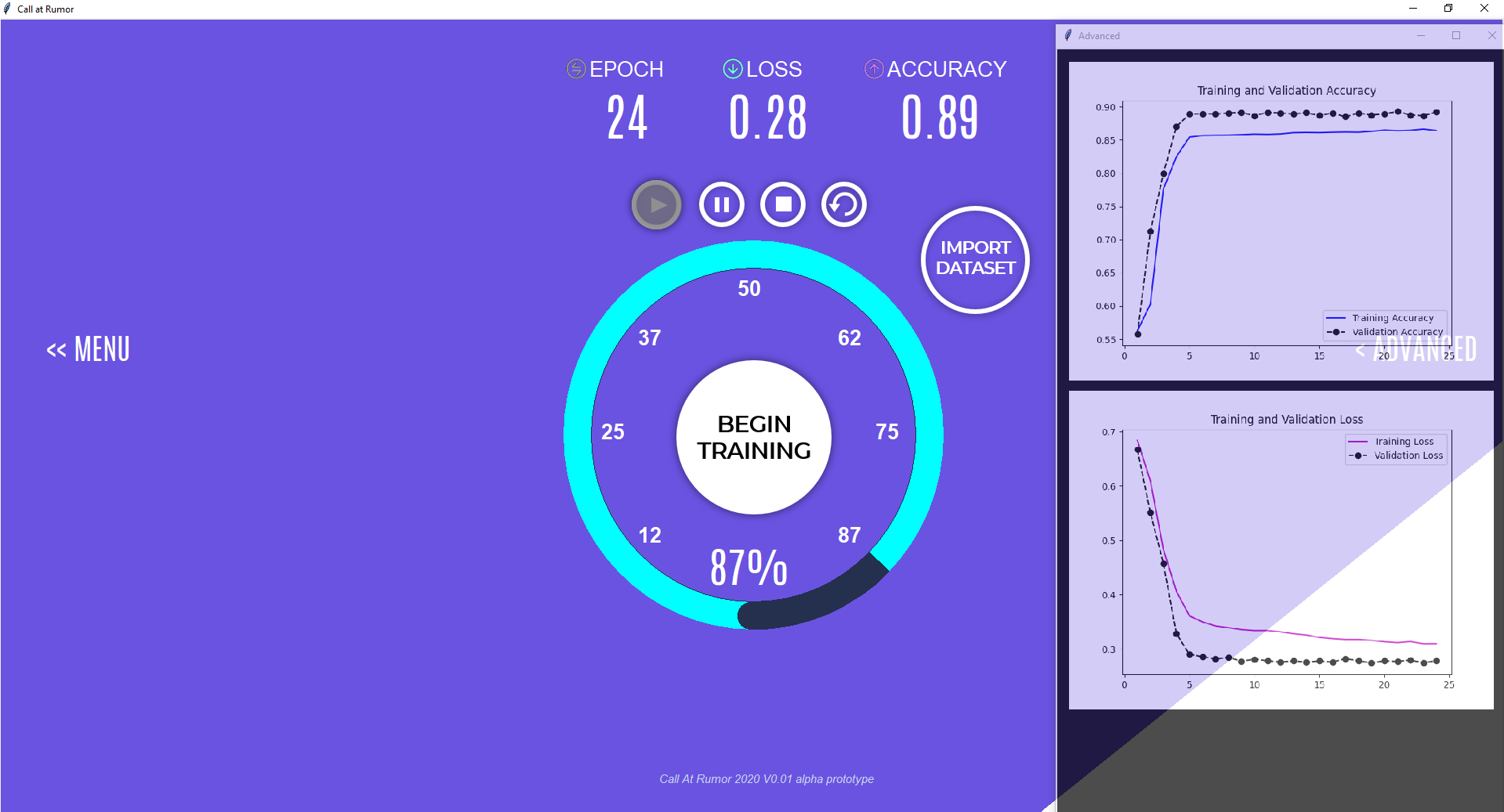
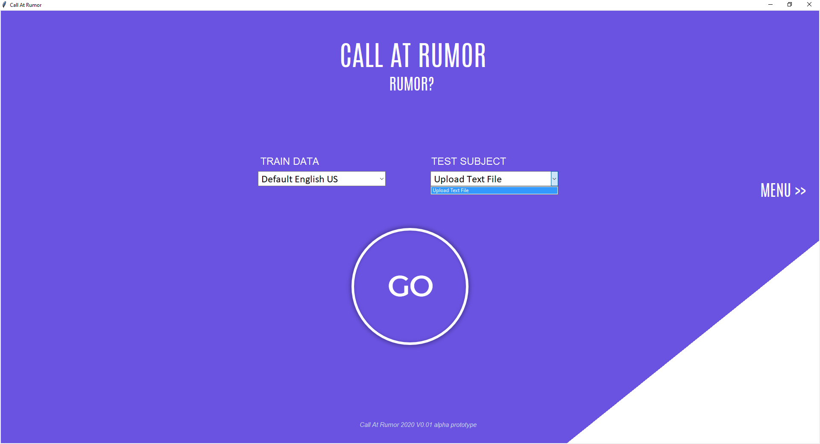
GRAPHICAL USER INTERFACE (GUI)

Slide 23
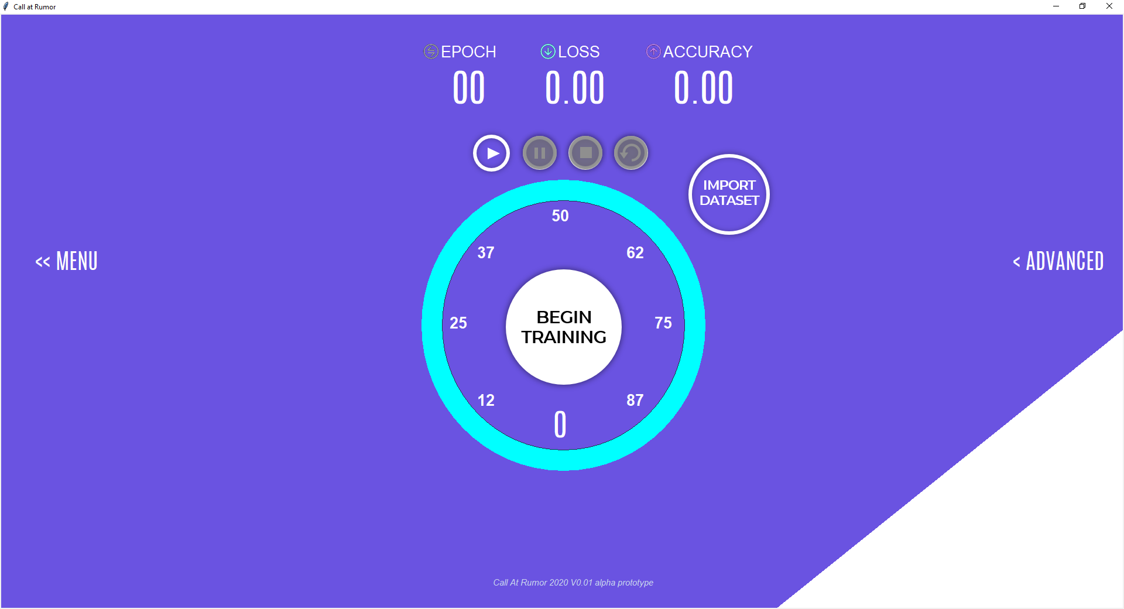
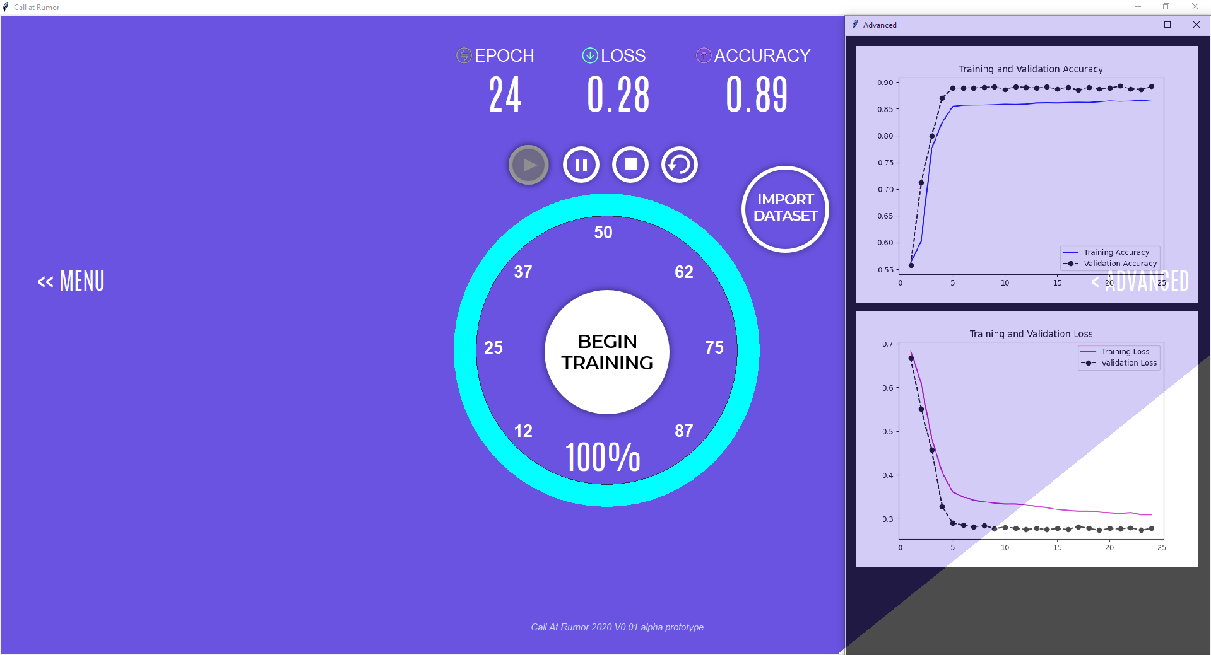
GRAPHICAL USER INTERFACE (GUI) - TRAINER
In the training window, the user can train an RNN with his own dataset! This enables users to train an RNN to work in their local languages as well as the default English language. The user will only need to provided the dataset and click on the BEGIN TRAINING button.
During the training process the user can view the available information in the ADVANCED tab by clicking it. Here he/she will see 2 graphs, the first illustrates the accuracy of the RNN and the second graph illustrates the loss of the RNN. The user is also able to view some more raw information about the training process like training times and some training cycle information.

Slide 24
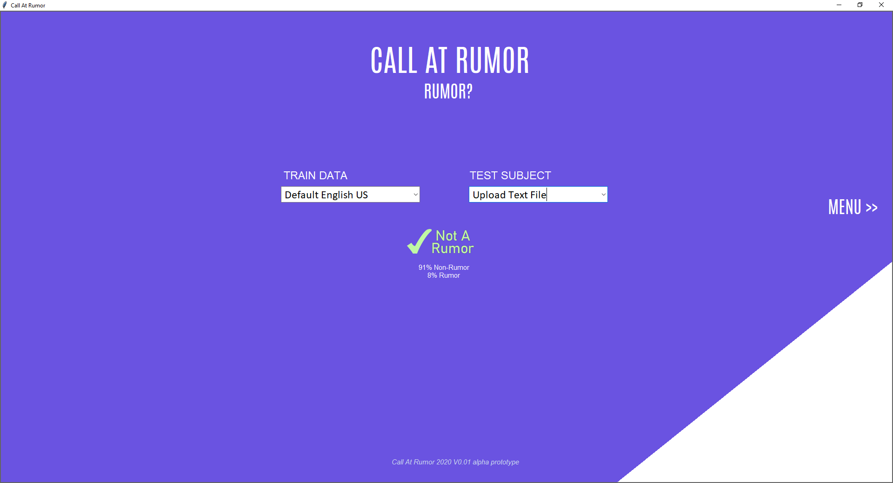
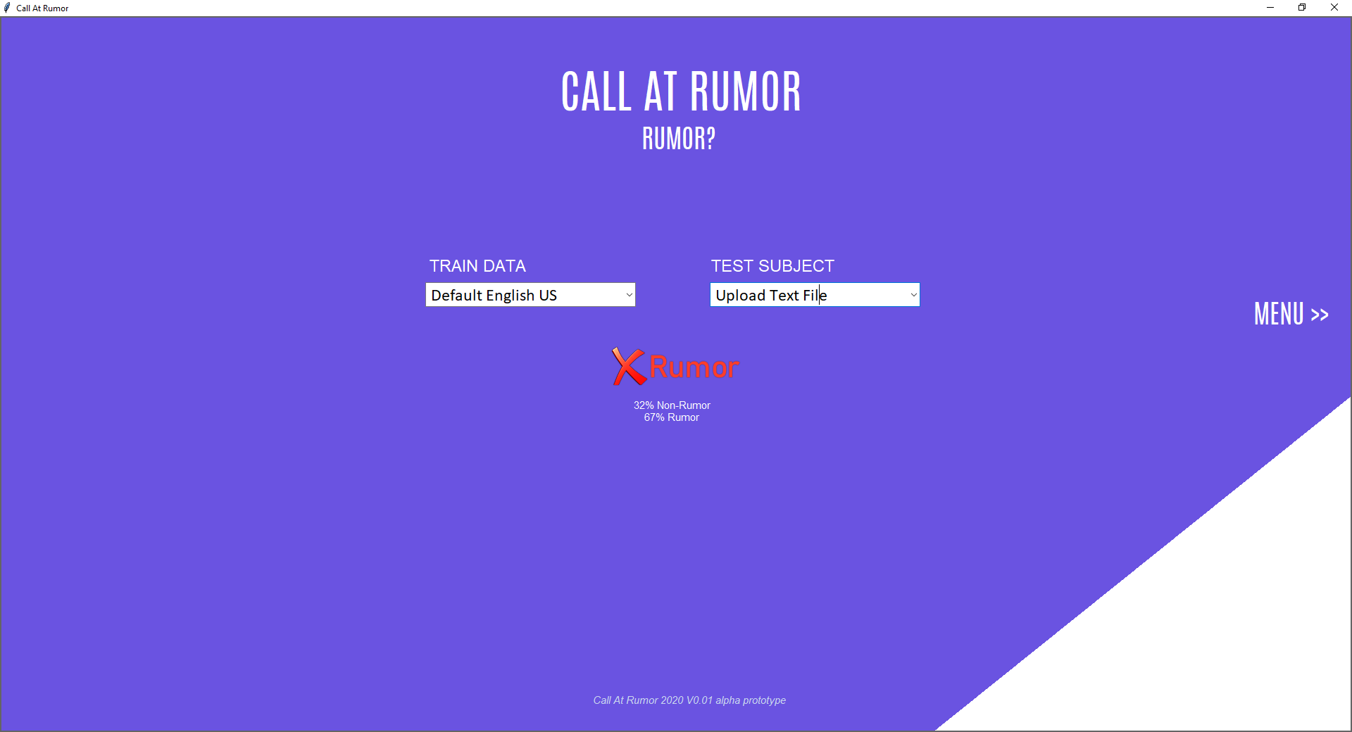
GRAPHICAL USER INTERFACE (GUI) - USER
The program predicts with 91% certainty that this is not a rumor
The program predicts with 67% certainty that this is in fact a rumor

Slide 25
TESTS
Test No. | Description | Expected Result | Pass /Fail
1. | Upload an empty text file on the rumor prediction page and press on the button “Go”. | An error window will pop-up – “file must be not empty”. | Pass
2. | Upload an incorrect file type as the dataset for training on the Training Page. | An error window will pop up – “Make sure it is a valid .CSV file” | Pass
3. | Press on the “Go” button on the rumor prediction without uploading a text file and pre-trained data. | The model will run on a default pre-trained data set “Default English US” a default text. | Pass
4. | Import a new pre-trained dataset (H5 file) on the rumor prediction. | The open dialog window will pop-up. | Pass
5. | Import an incorrect file type for pre-trained model on the on the rumor prediction page. | An error window will pop up – “Make sure it is a valid .h5”. | Pass
6. | Upload a text file that is not from the trained dataset, labeled as a rumor, and press on the “Go” button. | The GUI will show “Rumor” with a percentage below. | Pass
7. | Upload a text file that is not from the trained dataset, labeled as a not rumor, and press on the “Go” button. | The GUI will show “Not A Rumor” with a percentage below. | Pass
8. | Press on the button - “Import Dataset” on the training Page for uploading a new CSV file. | The open dialog window will pop-up. | Pass
9. | Press on the “Begin Training” button on the training page after importing a dataset. | The progress bar will start progressing, the play button will be dark, the pause and stop buttons will be white. The epoch, loss, and accuracy values will be displayed. | Pass
10. | Press on the “Advanced” button without training a dataset first. | Display an empty window on the right. | Pass
11. | Press on the “Advanced” button after training a dataset first. | Open a new window on the right with the loss and the accuracy graph. | Pass
12. | Press on the “Manu” button for returning to the main page. | The main page window will open. | Pass

Slide 26
CONCLUSION
The Examined Subject | Parameters | Validation Accuracy | Validation Loss | Epoch | Results Explanation
Preprocessing | Raw data | 0.884 | 0.310 | 31 | When the model is trained on the preprocessed data it receives a higher accuracy rate and lower loss within only 15 epochs.
 | Preprocessing | 0.894 | 0.274 | 15
Optimization algorithms | Adam | 0.894 | 0.274 | 15 | These test results show that Adam optimization receives a much higher accuracy rate and lower loss than SGD, although the RMSprop optimizer has some good results but not better than Adam.
 | RMSprop | 0.893 | 0.279 | 15
 | SGD | 0.557 | 0.692 | 2
Different partition of the dataset | 83% Training 17% Testing | 0.894 | 0.274 | 15 | When the dataset is split to 50%-50% the learning rate is slower as more data is taken from the training set, the accuracy and the loss are better in the original version.
 | 50% Training 50% Testing | 0.857 | 0.355 | 19
Activation function | Tanh | 0.445 | 0.693 | 2 | The sigmoid activation function drastically improves the overall performance of the model.
 | Sigmoid | 0.894 | 0.274 | 15
 | Relu | 0.557 | 0.693 | 2
Attention mechanism | Attention | 0.894 | 0.274 | 15 | When the attention mechanism is embedded in the system it receives a higher accuracy rate and lower loss and the learning rate is faster (only 15 epoch).
 | Attentionless | 0.893 | 0.276 | 21
Different parameters are examined

Slide 27
CONCLUSION
System automatically detects rumors
Using
LSTM (RNN)
Tf-idf
Attention Mechanism
Best identified settings:
Should preprocess the data
Splitting 83% for training and 17% for testing works best
Use the attention mechanism
Adam optimizer
Sigmoid activations

Slide 28
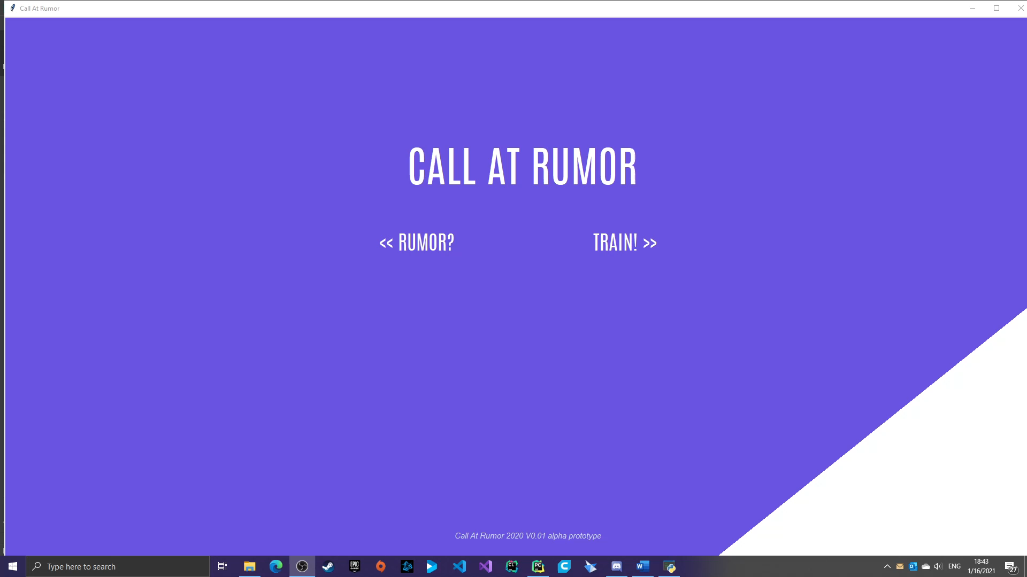

Slide 29
THANKS FOR LISTENING!

Slide 30
THANKS FOR LISTENING!

